Slide 1
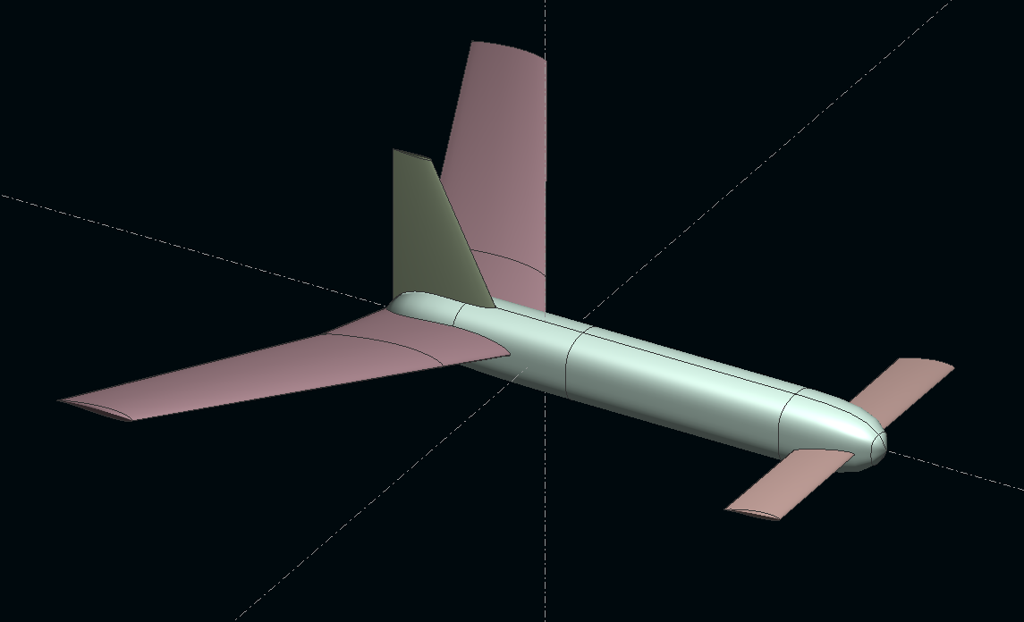
Unstallables
Design Review - October 13, 2017

Slide 2
Eduardo: Lift Distribution & Weight
Austin: Airfoil and Tail Design (Optimum L/D)
Kevin: Canard Cm Balance and Stall
Jenna: Stability
Dagan: Drawings

Slide 3
PERFORMANCE SUMMARY
Weight: 383g
Cruise L/D: 9.6
Cruise speed: 9.8 m/s
Minimum Speed: 7.9 m/s (Also known as stall speed for inferior designs)

Slide 4
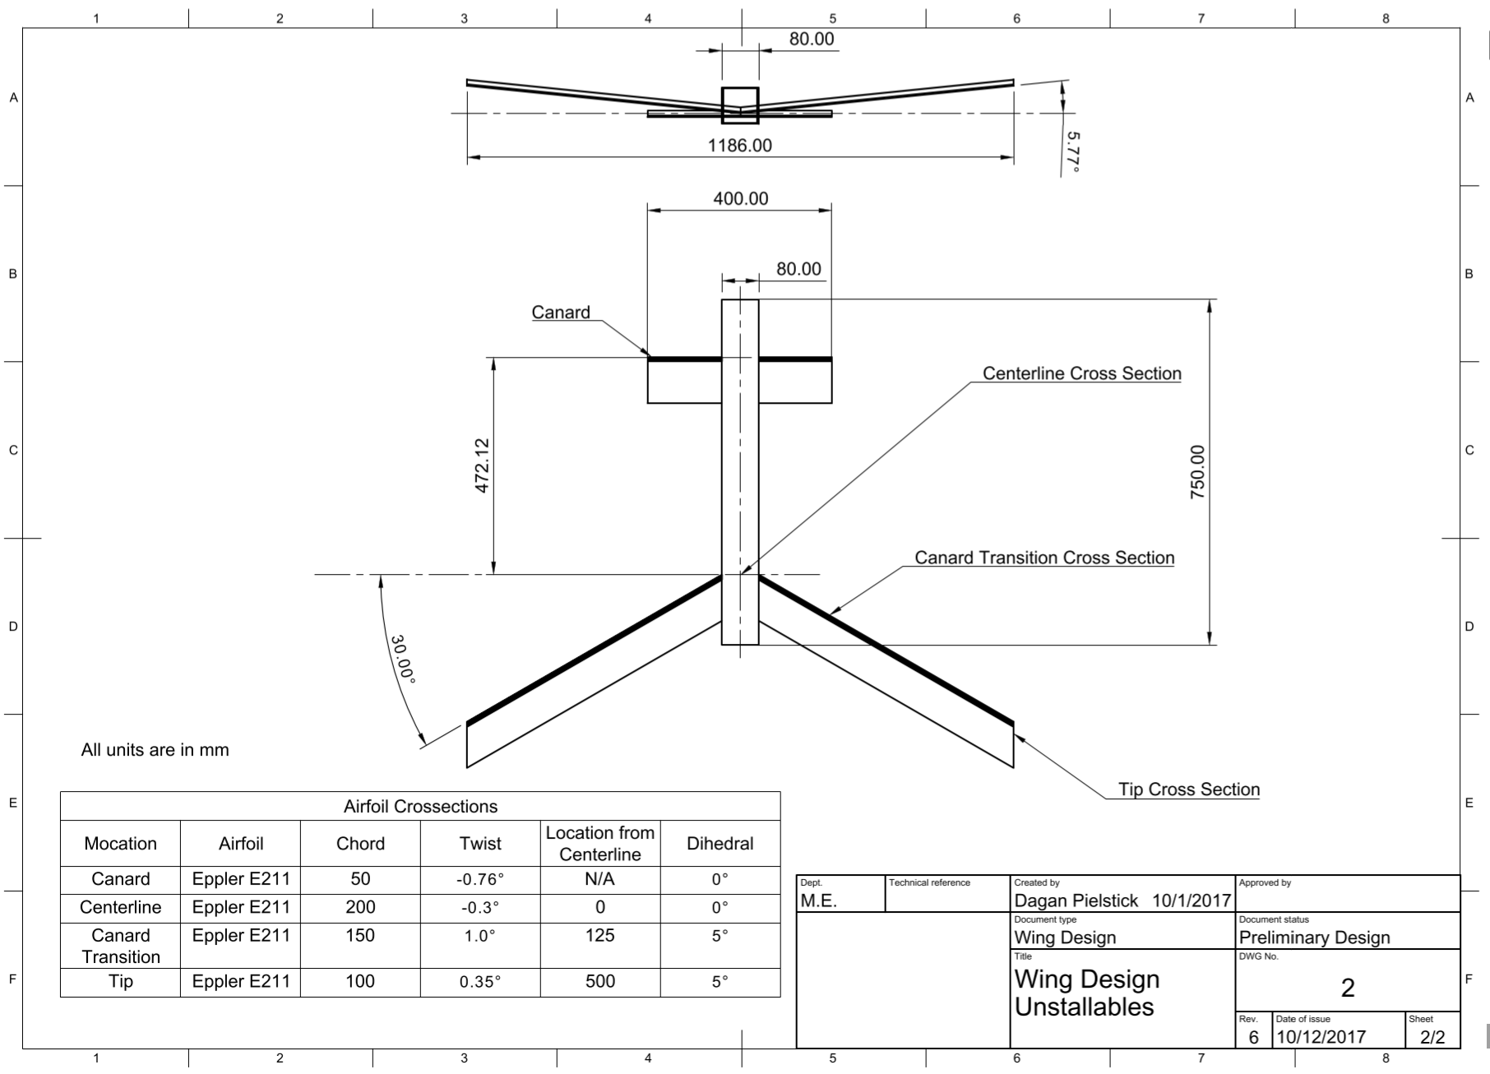
DIMENSIONS

Slide 5
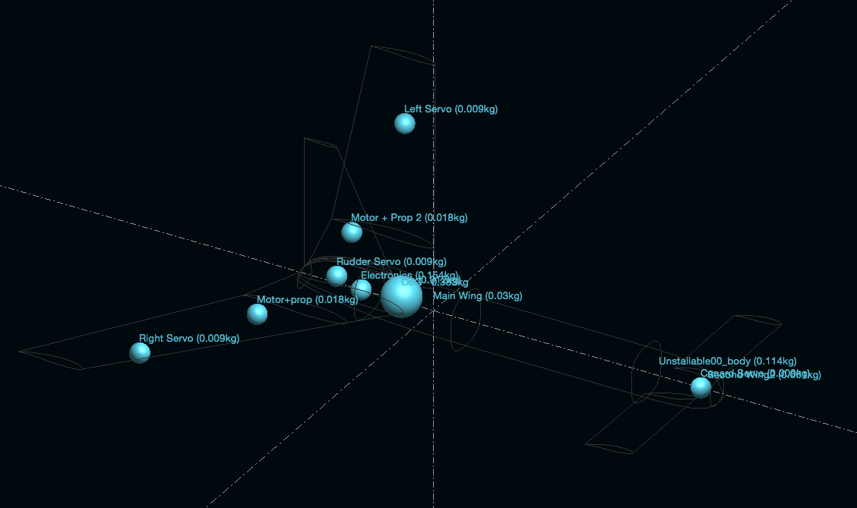
WEIGHT DISTRIBUTION

Slide 7
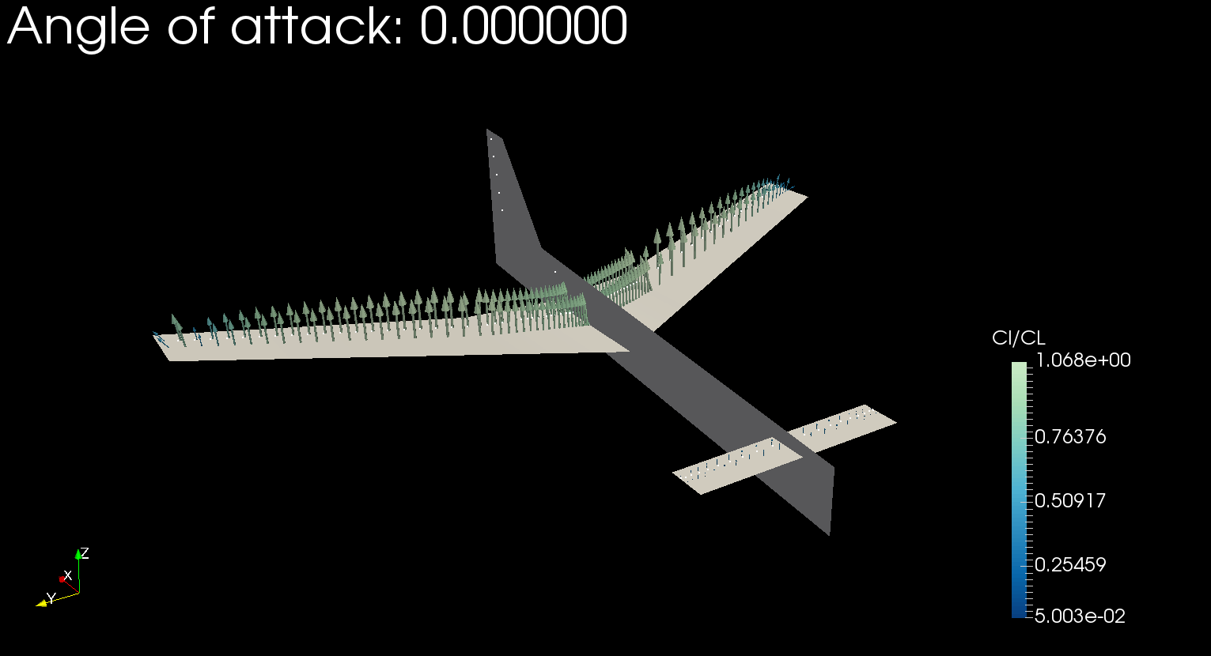
LIFT DISTRIBUTION

Slide 8
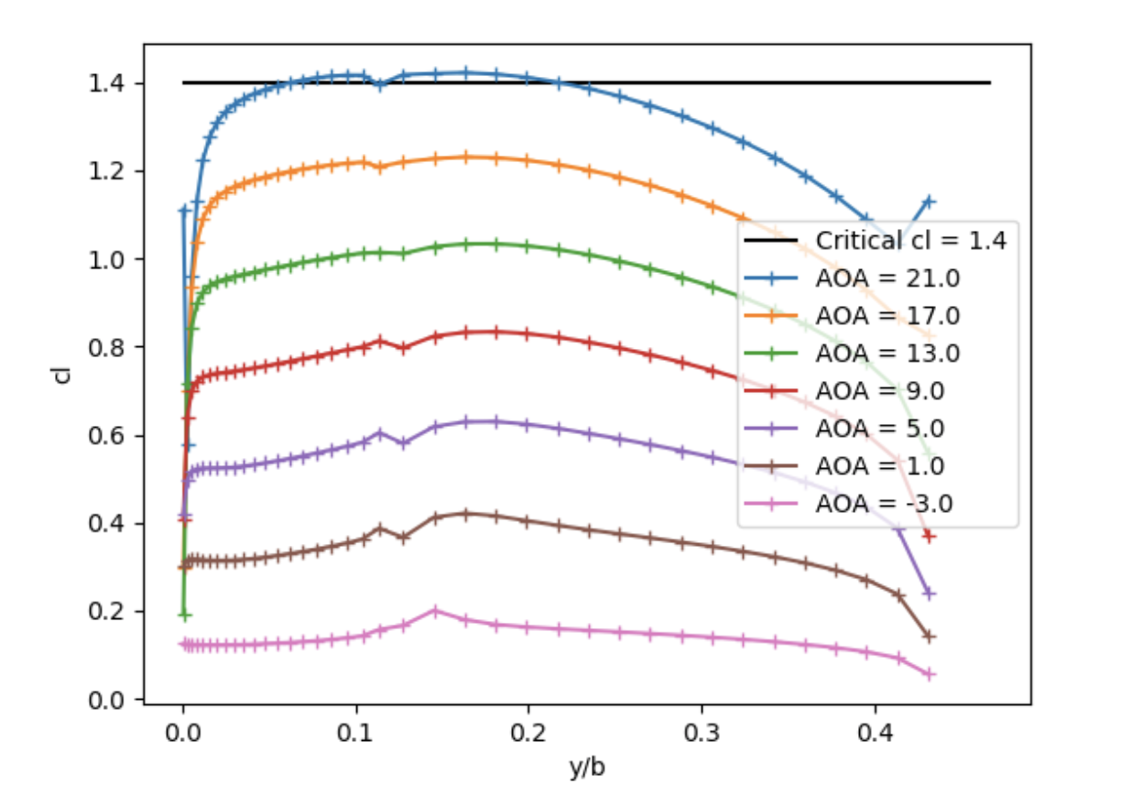

Slide 9
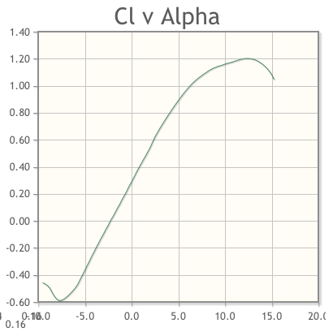
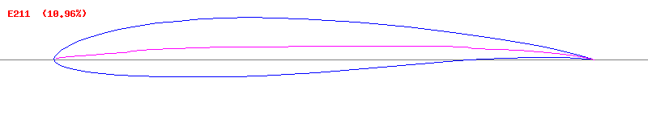
Airfoil Design
Used Xfoil to compare different airfoils
Chose airfoil based on lift curves and drag polars
Low drag at our design Cl
Good stall characteristic
Target CL at 0 degrees AOA
Looked at NACA 4412, Clark Y, E211. Chose E211

Slide 10
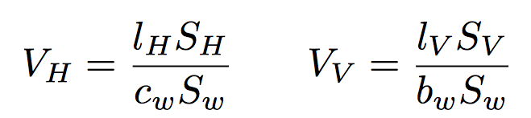
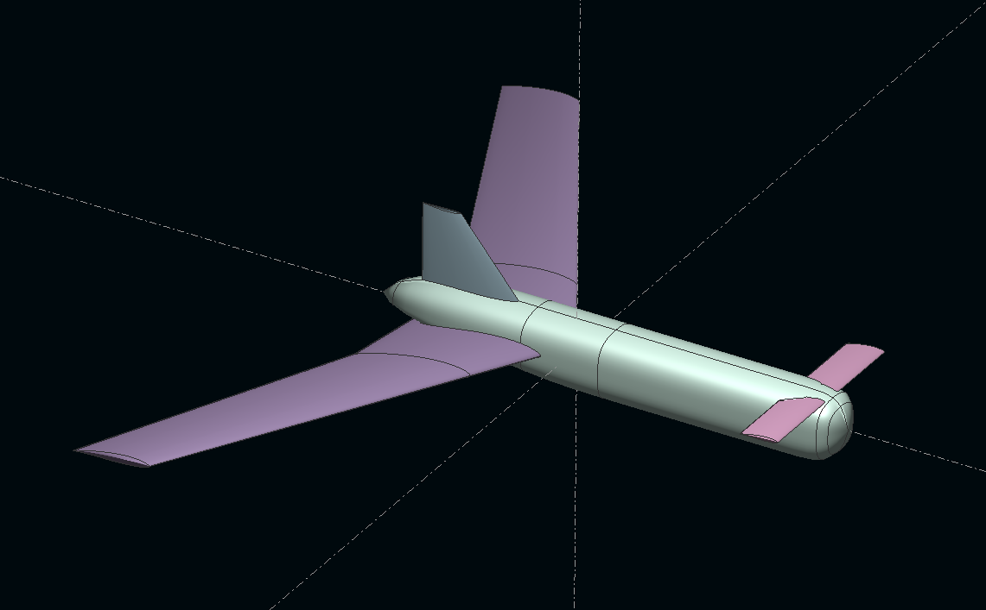
Vertical and Horizontal Tail Design
Based on Statistical Tail sizing.
Treated canard as horizontal tail
Current Values: Vv = 0.013; Vh = 0.615
Recommended Ranges: Vv 0.02-0.04 Vh 0.5-0.7
Original
Final

Slide 11
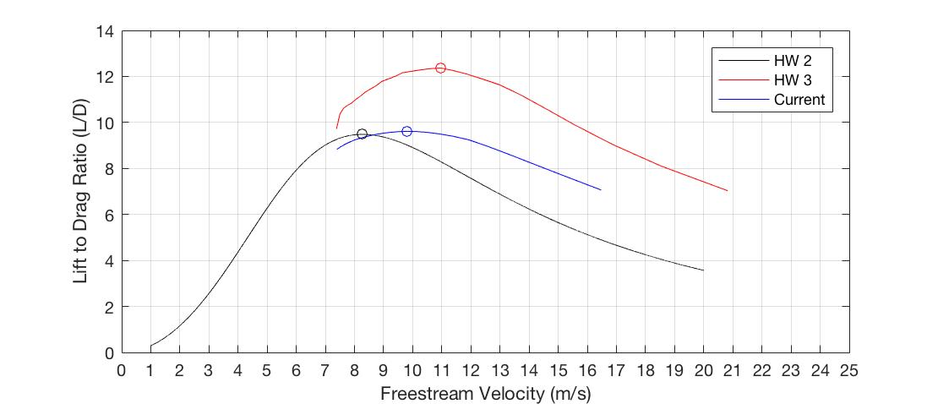
AOA ~= 0.0

Slide 12
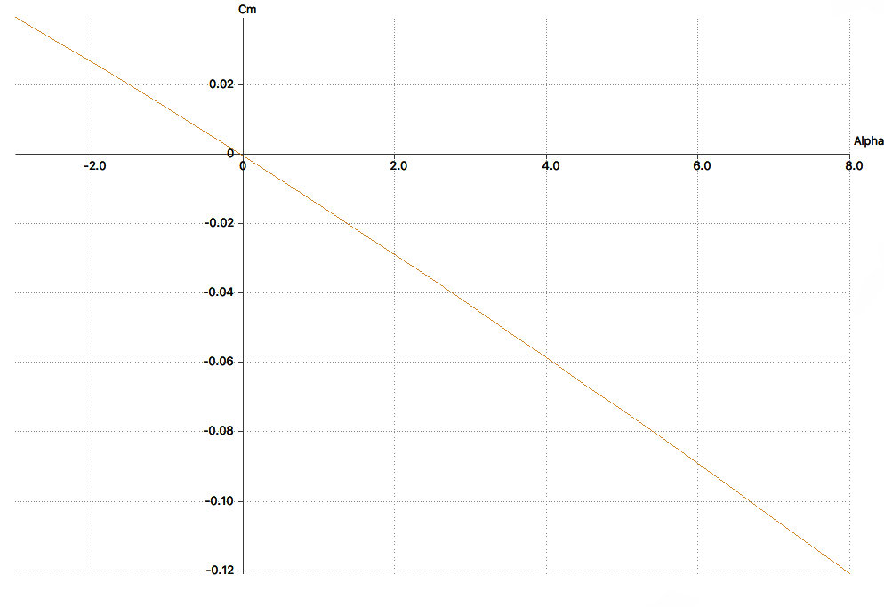
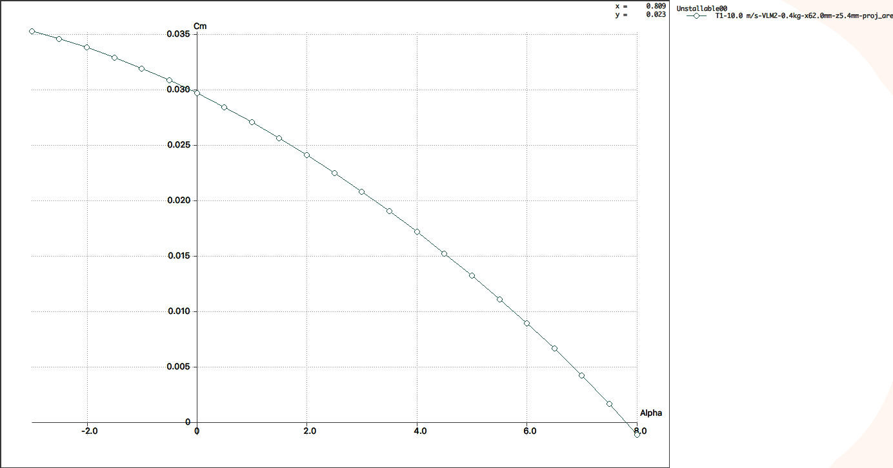
Unstallable!
Main wing by itself stalls at 12 degrees, CL is then 0.9
With canard, plane won’t go above 8 degrees
Canard Incidence: 0.8 degrees
Canard Incidence: 2.0 degrees
Balance @ 8 Degrees & Canard Stall

Slide 13
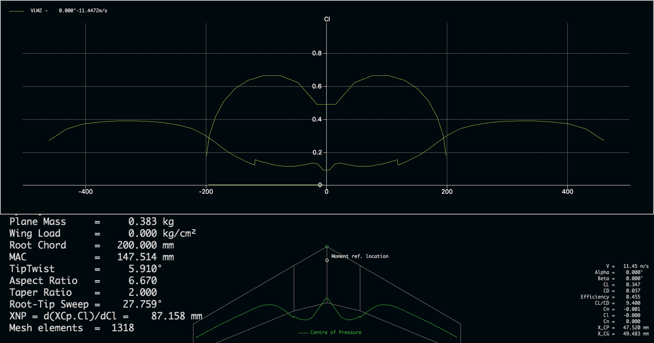

Slide 14
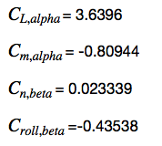
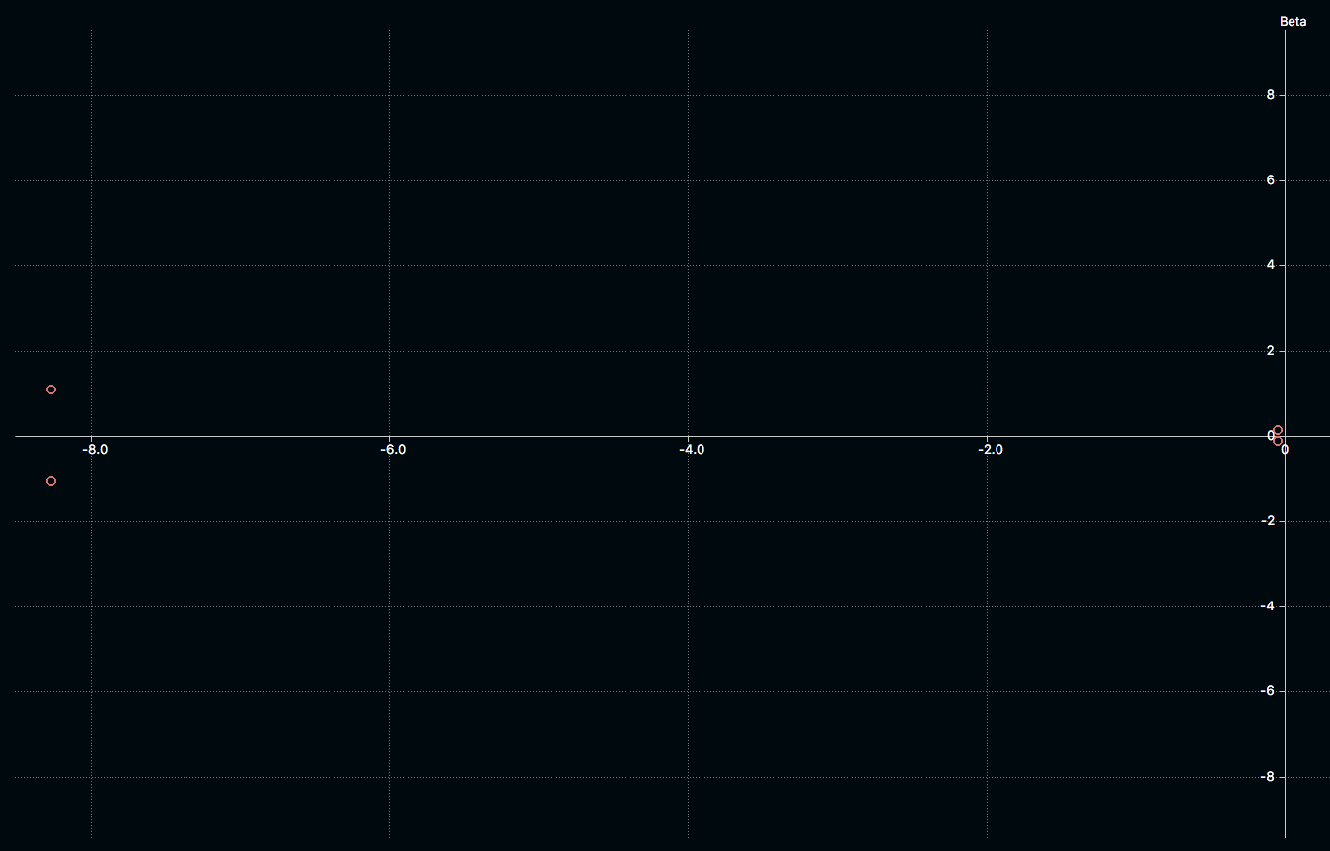
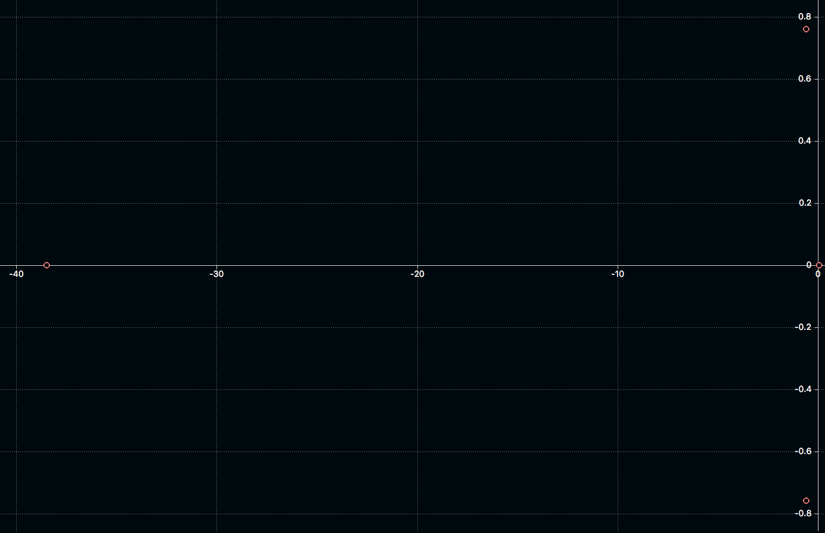
Stability
Longitudinal
Lateral
Static Margin: 12%

